Slide 1

Team 11
u
CASE Förebildarna

Slide 2
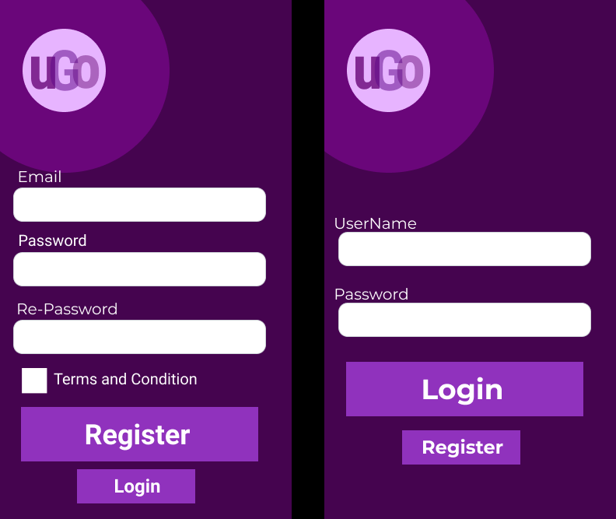

Slide 3
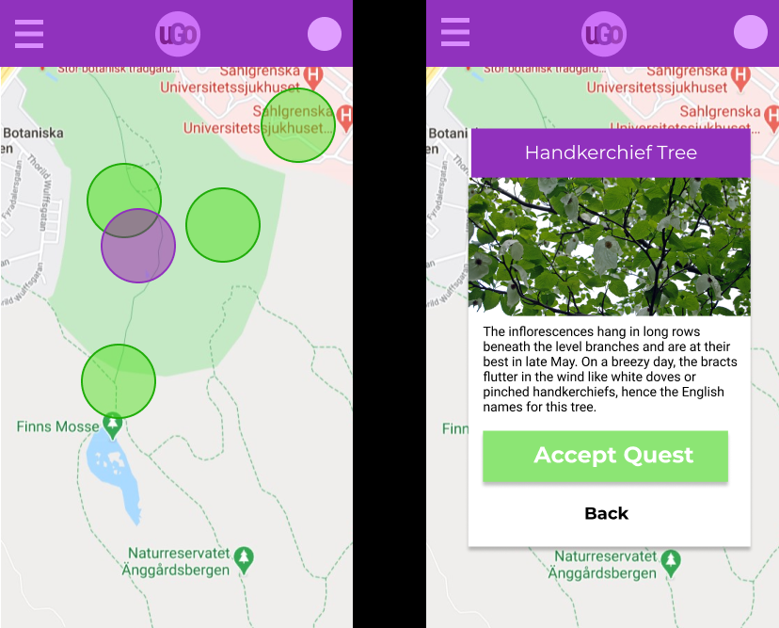

Slide 4
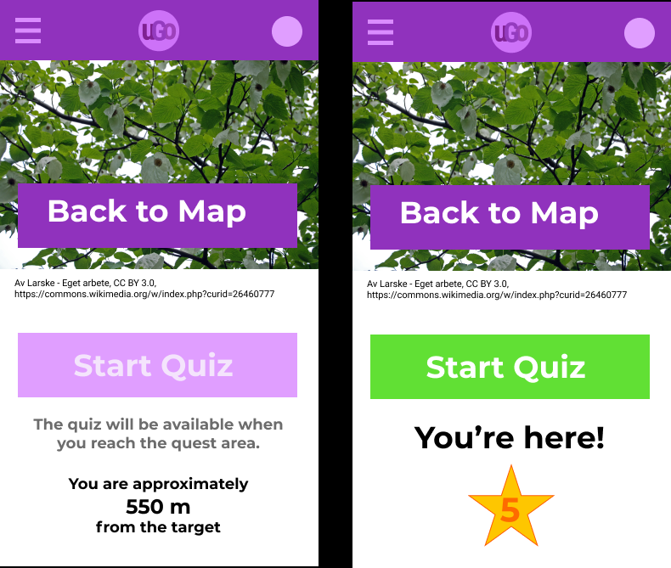

Slide 5
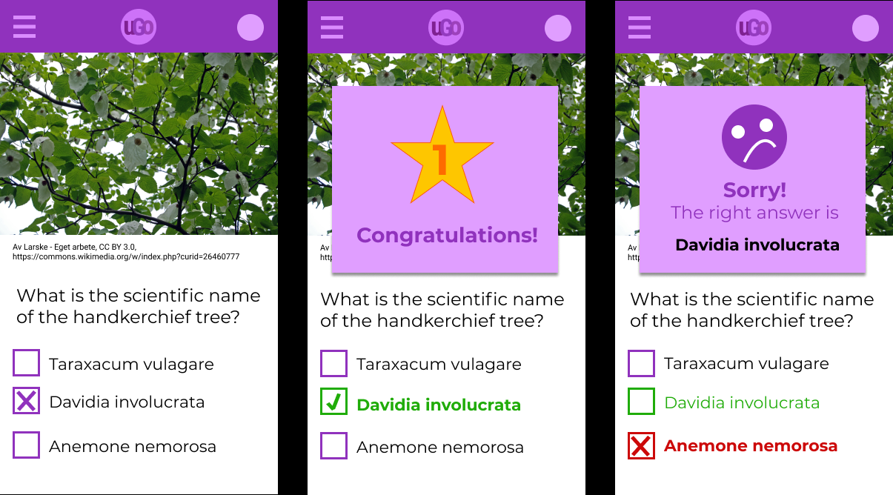

Slide 6
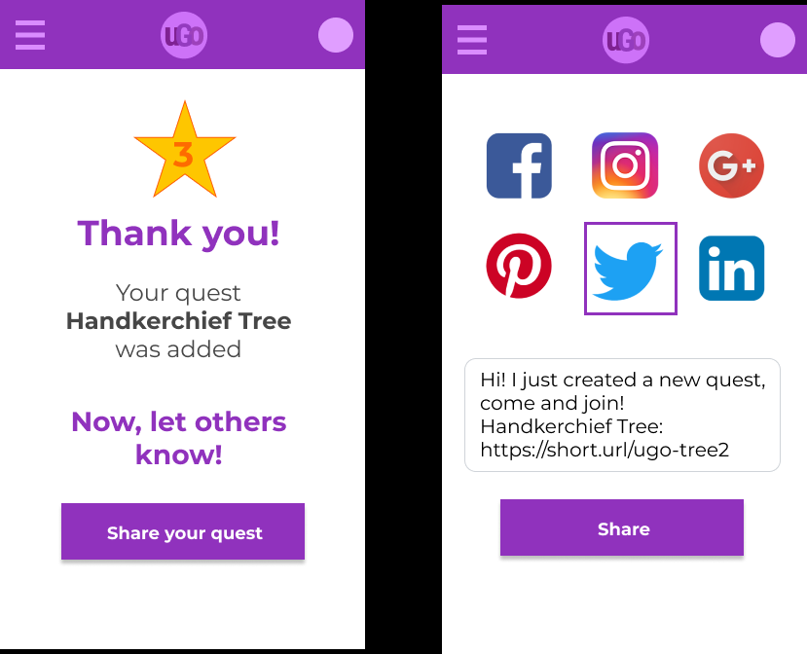

Slide 7
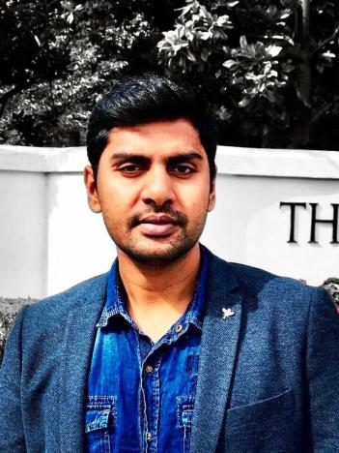
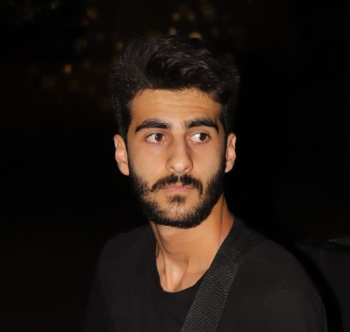

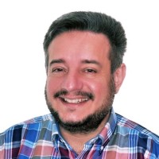
Meet our Team
Tilda B.
Bousios Michail
Mahabir Gupta
Karim Mrad
Passionate Pythonista
Senior Software Engineer
Software Developer
Computer Engineering Student

Slide 8
Sincere appreciation & Thanks
Mentors
Organising Committee
Gothenburg Hackathon
Our judges
GitHub link
https://github.com/mahavir9008/Ugo

